Slide 1

Introduction to PnP Core Component
Bernd Rickenberg
Chefudvikler
Pointwork

Slide 2
General Info
Check PC login, internet access, Visual Studio 2013, Office 365 SharePoint site and Azure management portal
Install Office Developer Tools for VS 2013 Update 1
Download dev camp material from GitHub, un-block and extract: https://github.com/andersdissing/spbg-codecamp-2016-08-16
Slides and hands-on
Knowledge of SharePoint/Office 365 development is not required!
Notes:
Forgot to enable Azure management portal for Office365 tenant?
https://blogs.msdn.microsoft.com/exchangedev/2014/04/07/enabling-microsoft-azure-portal-access-to-manage-applications-using-the-oauth2-protocol/

Slide 3
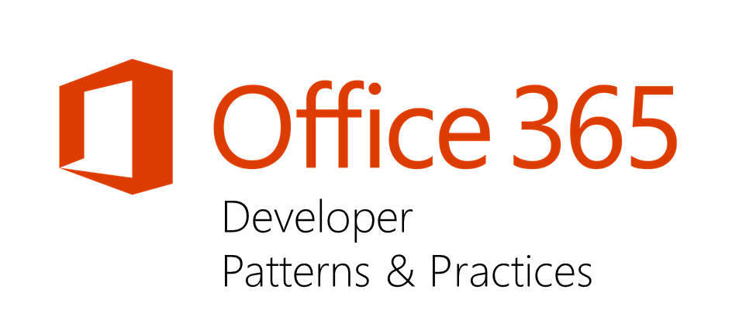


Sharing is caring…
Code samples/components
Guidance documentation
Monthly community calls
Web casts, videos, podcasts
Themes
SharePoint framework
SharePoint add-ins
Remote provisioning
APIs and Client side development
http://aka.ms/OfficeDevPnP
Notes:
Formed in 2013 by a group of Microsoft consultants who were working on FTC to CAM transformations
PnP guidance has started evolving to other areas as well, including Office 365 APIs, Office Add-ins and unified APIs
PnP program has now evolved as open source community effort with both internal and external contributors
Core team of MS employees and externals is the driving force behind PnP
Note: Office 365 Dev PnP is not directly linked with the official Patterns and Practices team at Microsoft, which concentrates more on the general development topics.
Code samples on GitHub - https://github.com/OfficeDev/PnP/tree/master/Samples or http://dev.office.com/patterns-and-practices-resources
UI Components on GitHub - https://github.com/OfficeDev/PnP/tree/master/Components
PnP Core Component on GitHub - https://github.com/OfficeDev/PnP-Sites-Core
Guidance documentation on MSDN - https://msdn.microsoft.com/pnp_articles/office-365-development-patterns-and-practices-solution-guidance or http://dev.office.com/patterns-and-practices-resources#?filters=Guidance
Monthly community calls on dev.office.com – every 2nd Tuesday of the month, recordings on PnP YouTube channel
Web casts, videos and podcasts on dev.office.com
Guidance example: Upload large files sample app for SharePoint

Slide 4

Agenda
What is PnP Core Component?
Overview of capabilities
How to start using PnP Core Component?
Notes:
Today we focus on the PnP Core component only – the other areas of Office Dev PnP are not covered.

Slide 5
What is PnP Core Component?
Open source extensions on top of native SharePoint CSOM and REST APIs for managed code
Separate versions for SharePoint Online and on-premises*
15 – SP2013 on-premises
16 – SP2016 on-premises*
16.1 – SharePoint Online
Simplifies remote development for any managed code from provider hosted add-in/app or windows code
Notes:
Wrapper and extensions to simplify coding with the SharePoint CSOM and REST APIs.
Re-build key areas of server-side functionality that are not directly available to client-side solutions.
Make it easier and faster to use the SharePoint APIs.
Alternative:
SPMeta2 - It offers a consistent provisioning API via SSOM/CSOM for SharePoint 2010, 2013 and O365: http://docs.subpointsolutions.com/spmeta2/

Slide 6
What do you get via the PnP NuGet package?
Online | On-premises (v15, v16*)
Files delivered via the PnP package
OfficeDevPnP.Core.dll | OfficeDevPnP.Core.dll
 | Microsoft.Online.SharePoint.Client.Tenant.dll
Files delivered via “dependencies” in the PnP package
Microsoft.SharePoint.Client.dll | Microsoft.SharePoint.Client.dll
Microsoft.SharePoint.Client.Runtime.dll | Microsoft.SharePoint.Client.Runtime.dll
Microsoft.Online.SharePoint.Client.Tenant.dll
Microsoft.SharePoint.Client.*.dll – Other CSOM assemblies for SPO | Microsoft.SharePoint.Client.*.dll – Other CSOM assemblies for On-prem
SharePointContext.cs / SharePointContext.vb | SharePointContext.cs / SharePointContext.vb
TokenHelper.cs / TokenHelper.vb | TokenHelper.cs / TokenHelper.vb
SharePointContextFilterAttribute.cs / SharePointContextFilterAttribute.vb (MVC only) | SharePointContextFilterAttribute.cs / SharePointContextFilterAttribute.vb (MVC only)
Notes:
Release every month (current version is November 2016), can include breaking changes, three versions following the CSOM versioning
Note: The Tenant assembly for on-prem is included in the NuGet package because there is no NuGet package with it available (only for the Online version)
Note: For the Authentication Manager to work you must manually add the ADAL NuGet package called ‘Microsoft.IdentityModel.Clients.ActiveDirectory’ – currently in version 2.28 (2016-11-16), which is not the latest version

Slide 7
PnP Core Component – Use cases
Extension Methods
Remote Timer Job Framework
Authentication Manager
Site Provisioning Framework
PnP PowerShell CmdLets

Slide 8
Extension methods
Extension methods on top of the native CSOM objects
One line code methods for different use cases
Available after normal using statement to Microsoft.SharePoint.Client namespace
Manage settings and artefacts cross SharePoint objects
Sites
Lists
Page content
Content types and fields
Etc.
// Create content type and document library. Associate just created content type to the library.
ctx.Web.CreateContentType("PnPDoc", "0x010100E3B9B3214A7D4C68BEE4004B58B3ADD7", "PnP Group");
var list = ctx.Web.CreateList(ListTemplateType.DocumentLibrary, "PnP Documents",, enableContentTypes: true);
list.AddContentTypeToListByName("PnPDoc", true);

Slide 9
Remote timer job framework
Easy operations to handle executions cross multiple sites and site collections in SharePoint
Multi-threading support
Authentication options
Dynamic scope (=sites to operate on)
State management
Logging
Scheduled execution which accesses the needed resources from the SharePoint service and performs the required automation.
Can use either specific account for connection or oAuth based app-only token approach
SharePoint Service
Business scenarios
Governance related tasks
Maintenance tasks
Fall back scenario for business logic depending on remote event receivers
Provider Hosted Apps
1
2
Remote timer job
Notes:
‘Replacement’ for SharePoint timerjobs running as Azure web jobs, Azure functions or scheduled tasks on-prem

Slide 10
Authentication Manager for managed code
Using CSOM code always requires you to have a ClientContext object:
Using the OOB SharePoint Add-In templates
Using custom code such as the PnP Authentication Manager when outside of an Add-In
var spContext = SharePointContextProvider.Current.GetSharePointContext(Context);
using (var clientContext = spContext.CreateUserClientContextForSPHost())
{ // your code }
Typical use cases are:
Console applications
Batch jobs
Governance jobs
Code that needs to run App-Only
Applications that interactively want to login
Applications registered in Azure AD
Notes:
Authentication against SharePoint for everything that is not a SharePoint add-in.

Slide 11
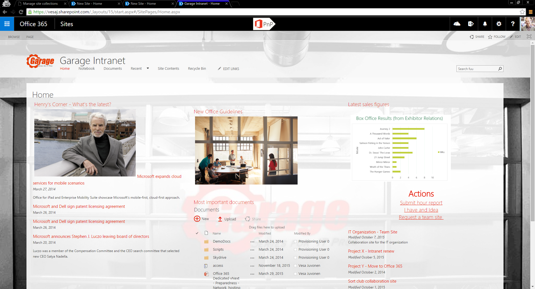
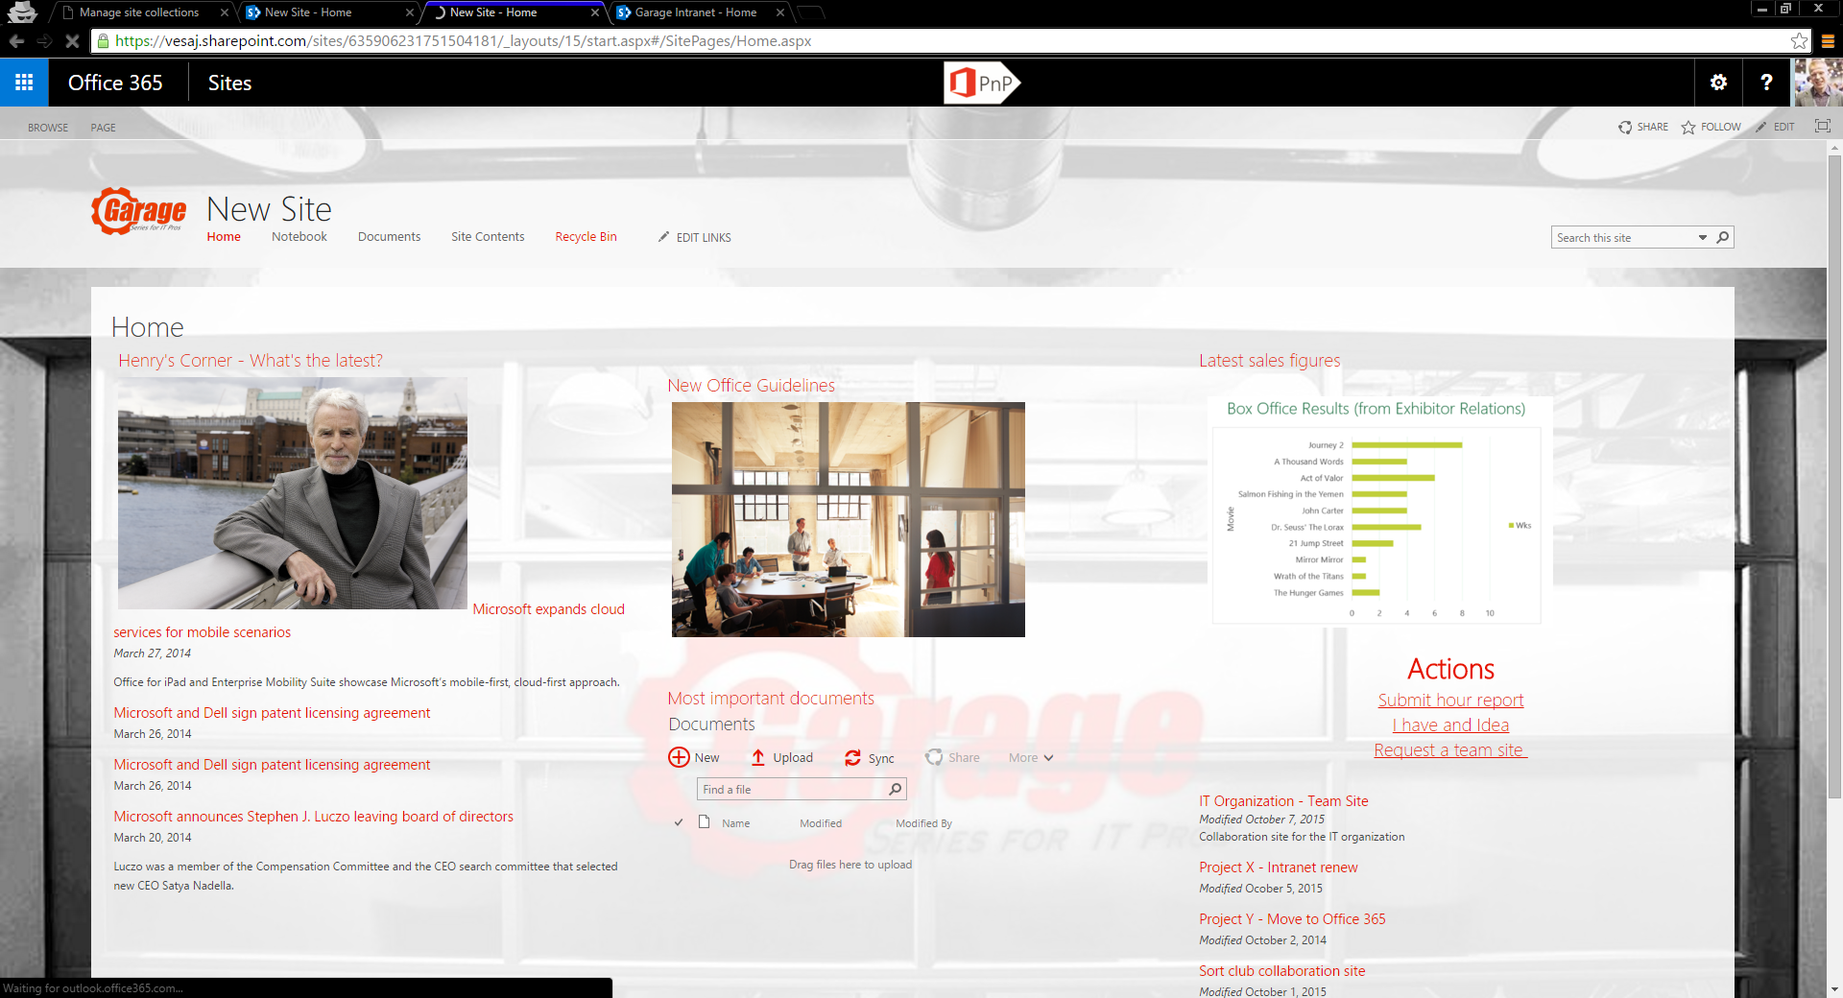
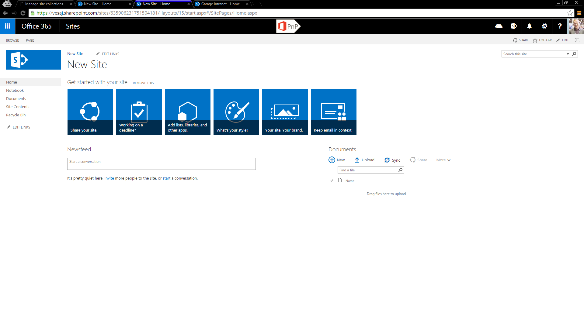
PnP Provisioning Engine – Simplistic story Export / Import use case
Template site
OOB site with needed configuration
Empty OOB site
Notes:
Configure your site, export the xml, tweak it and use it to provision new sites (not site collections).
Or
Create and update sites using XML files very similar to the feature XML for web templates, site definitions, list schemas, content types and fields.

Slide 12
PnP PowerShell – What is it for?
SharePoint Online Cmdlets
For administrative tasks
Creating sites
Removing sites
Adding users
Creating groups
Etc.
PnP Cmdlets
To manage artifacts in sites
Lists
Views
Fields
Upload files
Etc.
Connect-SPOnline -Url ‘https://contoso.sharepoint.com/sites/team’
New-PnPList -Title Docs -Template DocumentLibrary -Url lists/docs
Add-PnPField -List Docs -DisplayName ‘Location’ -InternalName ‘Location’ -Type Choice -Group ‘Demo’ -AddToDefaultView -Choices ‘London’, ‘Helsinki’, ‘Stockholm’
Notes:
Handy because working with CSOM in PowerShell is not a lot of fun, because it does not support Lambda expressions.
New prefix introduced with November 2016 release.
Wraps all PnP Core methods with PowerShell command-lets.
Work-around on Gary Lapointe blog: https://www.itunity.com/article/completing-basic-operations-sharepoint-csom-api-powershell-1278

Slide 13
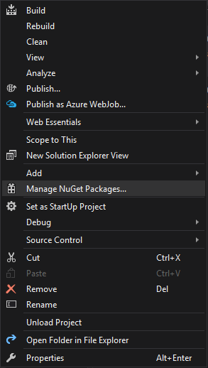
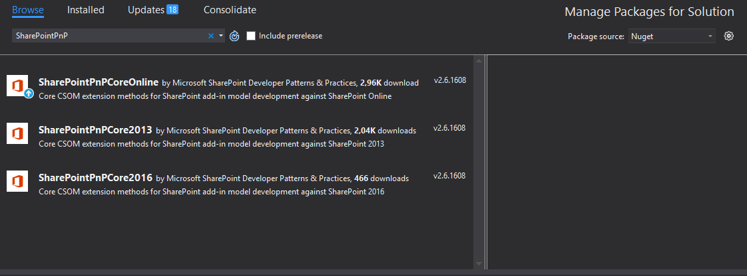
PnP Core Component – How to use?
PnP Core Component is available from NuGet Gallery
Search for ‘SharePointPnP’ from NuGet gallery
Results will show the latest versions of the PnP Core Component
Installation from NuGet Gallery will include most dependencies
Notes:
Package source must be NuGet and choose the appropriate version.

Slide 14
PnP Core Component versioning and updates
We release new version of the PnP Core Component as part of monthly PnP releases
Automated daily unit tests for dev branch and more comprehensive testing for monthly releases
Baseline CSOM for each environment
SharePoint Online – Latest available Nuget
SharePoint 2016 – RTM
SharePoint 2013 – 2015 April CU
Old versions are kept in NuGet Gallery for backwards compatibility purposes
New versions are backward compatible
Any breaking changes will be notified by deprecating methods at least 2 months before they are removed from released version
Notes:
Be aware of breaking changes. Happens all the time.

Slide 15
PnP is a community project!
Feel free to contribute with Issues, Pull Requests, Yammer threads
Notes:
Do not expect it to be perfect. Plan for implementing fixes and please commit them back via a pull request.

Slide 16
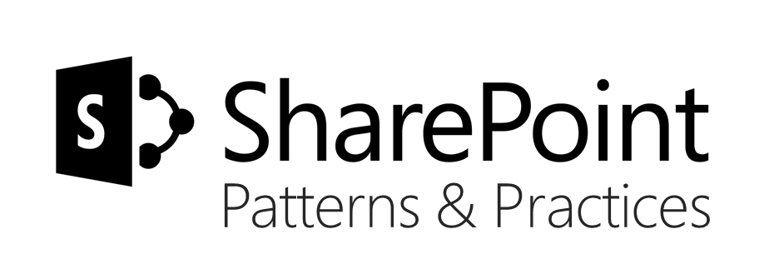






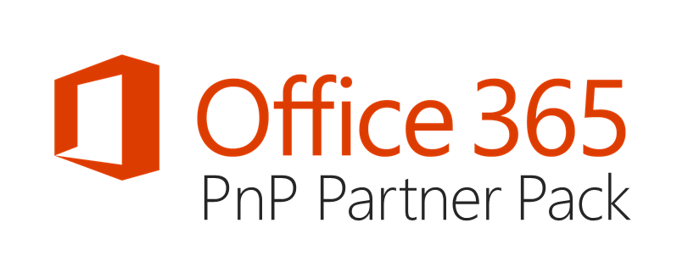

aka.ms/OfficeDevPnP
https://github.com/OfficeDev/PnP
https://github.com/OfficeDev/PnP-Sites-Core
https://github.com/OfficeDev/PnP-PowerShell
https://github.com/OfficeDev/PnP-Tools
https://github.com/OfficeDev/PnP-Guidance
https://github.com/OfficeDev/PnP-Transformation
https://github.com/OfficeDev/PnP-OfficeAddIns
https://github.com/OfficeDev/PnP-Provisioning-Schema
https://aka.ms/OfficeDevPnPVideos
https://aka.ms/OfficeDevPnPMSDN
https://aka.ms/OfficeDevPnPYammer
https://docs.com/OfficeDevPnP
@OfficeDevPnP
https://aka.ms/OfficeDevPnPCall
https://aka.ms/OfficeDevPnPPartnerPack

Slide 17
Q&A

